Slide 1

Introduction to Plasmate
Giorgos Tsiapaliwkas
KDE Plasma Developer
terietor@gmail.com
Antonis Tsiapaliokas
KDE Plasma Developer
kok3rs@gmail.com

Slide 2
Plasma Vocabulary
Plasma Applets or Plasmoids
Plasma Dataengines
Plasma Runner

Slide 3
Plasma Libraries
Before Qt 4.7.x
    QGraphicsView Framework
After Qt 4.7.x
    QGraphicsView Framework
    Qt Quick
    QML

Slide 4
Plasma Package Structure
$PackageName-$PackageVersion/
metadata.desktop
contents/
    code/
      files containing scripting code
      the main file that will be loaded at plasmoid start (unless you specify a different name in metadata.desktop)
    images/
        image files in svg, png or jpeg format
    locale/
        translation files in a standard localization hierarchy; e.g. German translation would appear in locale/l10n/de/
    ui/
        user interface files, such as Qt Designer layouts
        config.ui the main configuration dialog layout
    config/
        KConfigXt files describing the configuration
        main.xml the main configuration description

Slide 5
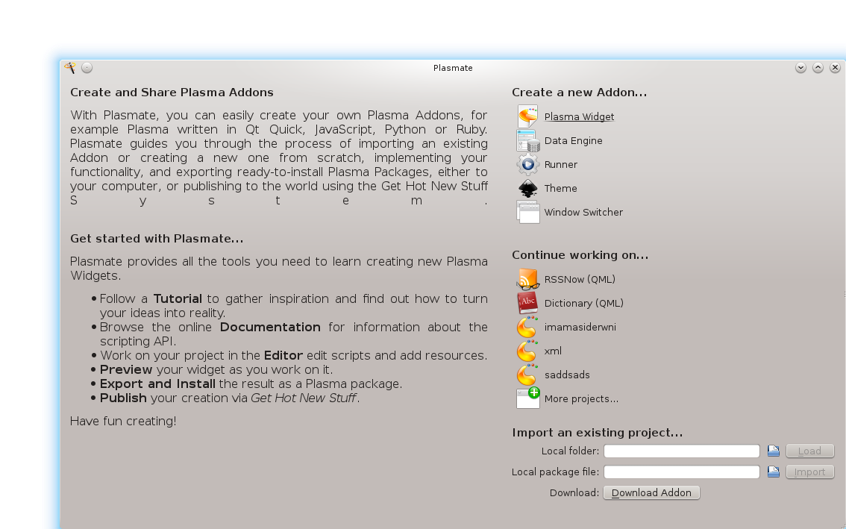
Plasmate
Plasmate is the Plasma IDE

Slide 6
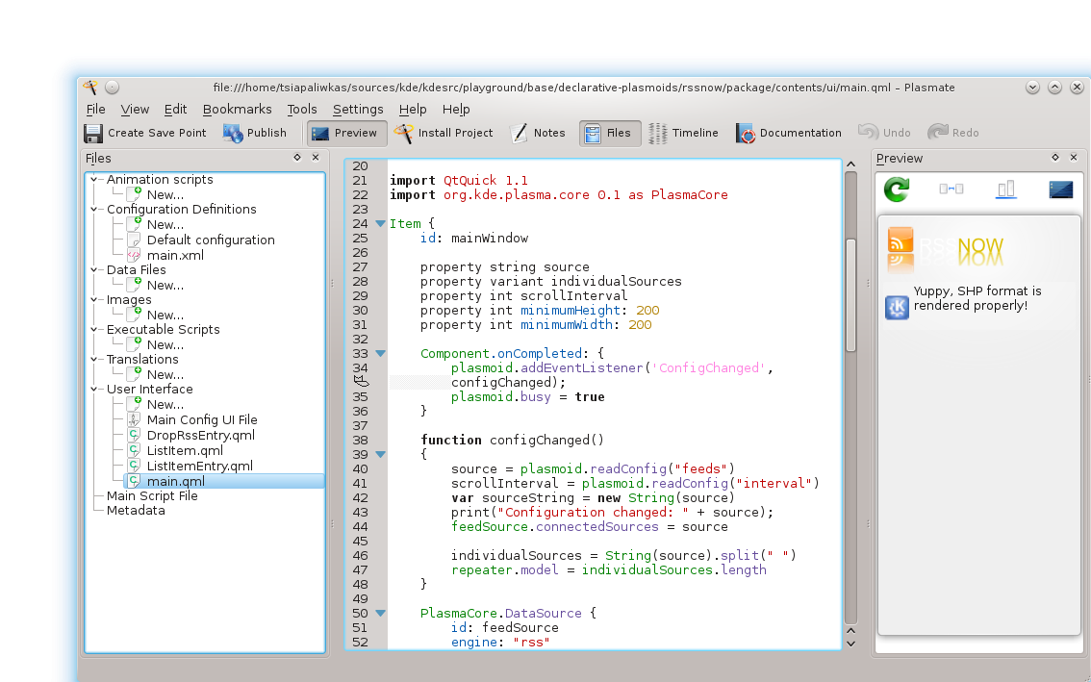
Plasmate

Slide 7
Plasmate GsoC 2012 Projects
Project: Make Plasmate Ready For Release
Mentor: Sebastian Kügler(sebas)
Student: Giorgos Tsiapaliwkas(terietor)
Project: Intergrade KWin with Plasmate IDE
Mentor: Martin(mgraesslin)
Student Antonis Tsiapaliokas(kokeroulis)

Slide 8
Intergrade KWin with Plasmate IDE
Task 1
Add Window Switcher Support to Plasmate
Problem
On slower systems, running 3-4 applications together,
might turn the system very slow
Solution
A fake embedded previewer

Slide 9
Intergrade KWin with Plasmate IDE
Task 2
Add Kwin Scripting support for QML/Javascript based KWin Scripts
Problem
Since Kwin Scripts doesn't have a previewer,
we needed to create a konsole previewer,
for debug purposes.
Solution
Terietor's GsoC involves to add a konsole previewer
Benefits
Reuse of code between the two GsoC Projects

Slide 10
Intergrade KWin with Plasmate IDE
Task 3
Add Kwin support for Javascript based KWin Effects
Problem
Kwin effects must to be reload at some point,
and in order to reload them we need to use the dbus.
So we needed to create a konsole previewer,
for debug purposes, in case that something goes wrong
Solution
Terietor's GsoC involves to add a konsole previewer
Benefits
Reuse of code between the two GsoC Projects

Slide 11
Intergrade KWin with Plasmate IDE
Task 4
Add support for QML based Window Decorations to Plasmate

Slide 12
Make Plasmate Ready for Release
Task 1
Plasmate's editor doesn't support actions.(Like undo/redo,etc)
Problem
“Save” and “Save us” action

Slide 13
Make Plasmate Ready for Release
Task 2
Install remotely a plasma package
Problem
Plasmapkg used KApplication(replaced with QcoreApplication)
Plasma::Package::install() used to depend on Ui libraries

Slide 14
Make Plasmate Ready for Release
Task 3
Add a console which will contain the output from the debugger
Problem
Doesn't filter the output

Slide 15
Make Plasmate Ready for Release
Task 4
Fix KconfigXt editor

Slide 16
Make Plasmate Ready for Release
Task 5
Move Plasma SvgViewer
Read the elements of each svg

Slide 17
Make Plasmate Ready for Release
Task 6
Merge plasmoidviewer with plasma-previewer
Add support for the KDE_PLASMA_COMPONENTS_PLATFORM
enviromental variable

Slide 18
Make Plasmate Ready for Release
Task 7
Move the SDK tools into Plasmate

Slide 19
Plasma Contact
Mailing List: plasma-devel@kde.org
Irc: #plasma at irc.freenode.org
Wiki:Community.kde.org/Plasma

